Slide 1
Sales Analysis and Forecasting
Presented By:
Ebraam Girgis Shenouda Boules
Mohamed Ahmed Mohamed Fetyan
Hazem Hassan Ahmed Hassan
Abdelshafi Saeed Abdelshafi Elsayyed
Sayed Ahmed Sayed Elbaradei

Slide 2
Project Idea
Problem: AdventureWorks needs insights into sales performance and forecasting to improve decision-making around product sales, marketing efforts, and supply chain management.
Proposed Solution: A data-driven analysis and forecasting model that processes sales data, identifies key trends, and predicts future sales patterns. The solution includes Tableau dashboards to visualize the findings.
Unique Value Proposition:
Provides both current and forecasted sales insights.
Actionable data visualization via an interactive dashboard.
Enables decision-makers to adjust strategies based on data trends and predictions.

Slide 3
End Users + Features
Primary Users:
Decision-makers
Analysts
Key Features:
Sales Forecasting
Geographical Insights
Products Insights
How Features Solve Problems:
Provides accurate, real-time insights for decision-making.
Helps adjust marketing and product strategies to match sales trends.
Allows for tailored analysis by specific product lines or regions.

Slide 4
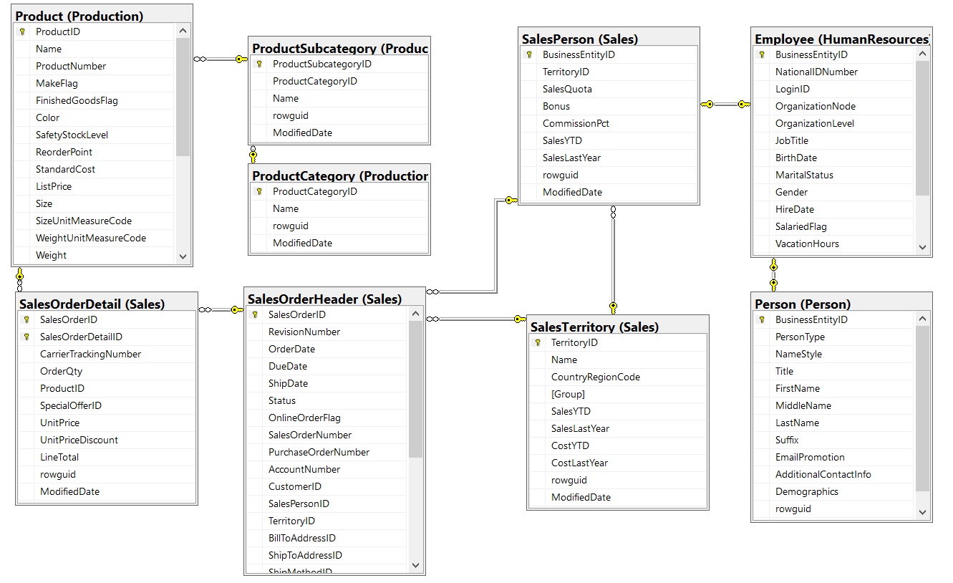
Data Structure
Database Architecture: Relational database using AdventureWorks 2019
Data Flow: Data is pulled from SQL databases, preprocessed with Python (pandas) for cleaning and transformations, and visualized in Tableau for final analysis and forecasting.

Slide 5
Programming Languages + Frameworks
Programming Languages:
SQL: For querying and data extraction.
Python: Data cleaning, preprocessing, and forecasting.
Frameworks/Tools:
pandas: For data manipulation.
Matplotlib: For visualizing trends during analysis.
scikit-learn: For forecasting (regression models).
Tableau: For data visualization and interactive dashboard creation.

Slide 6
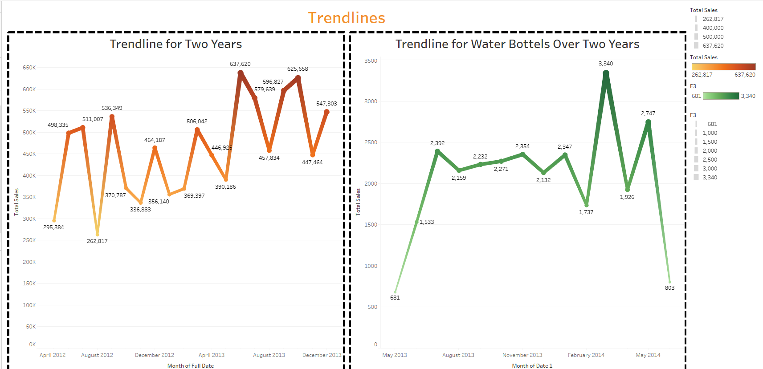
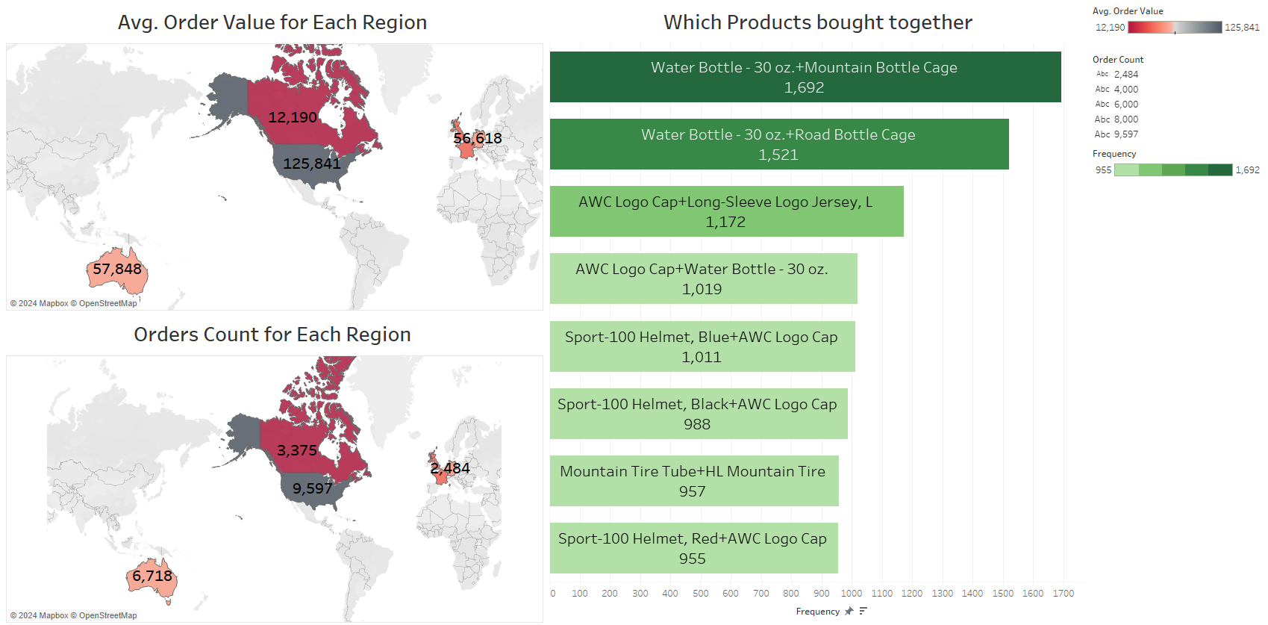
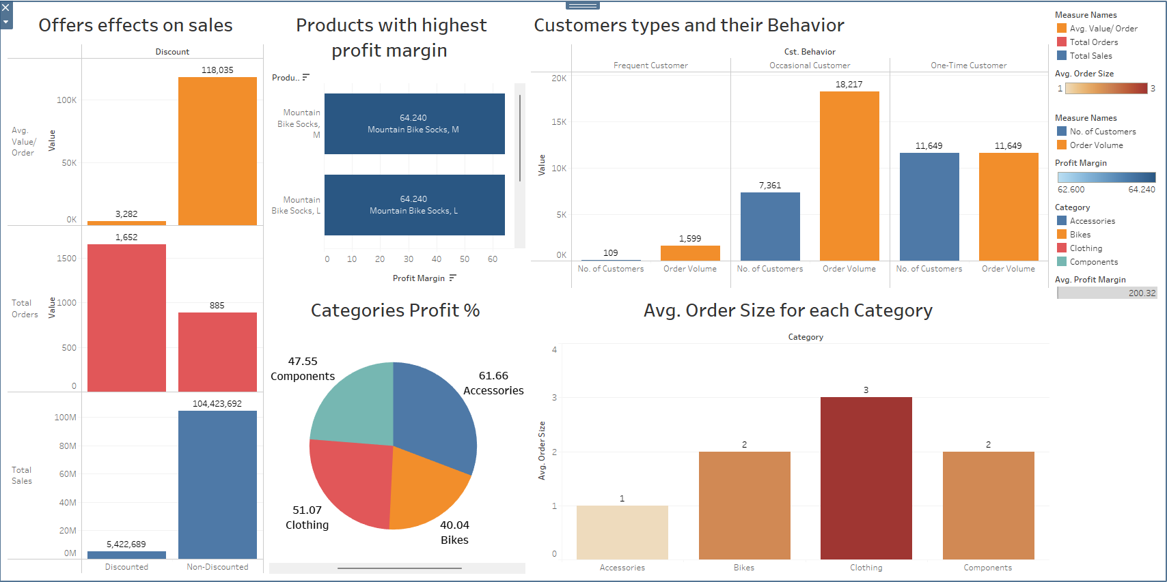
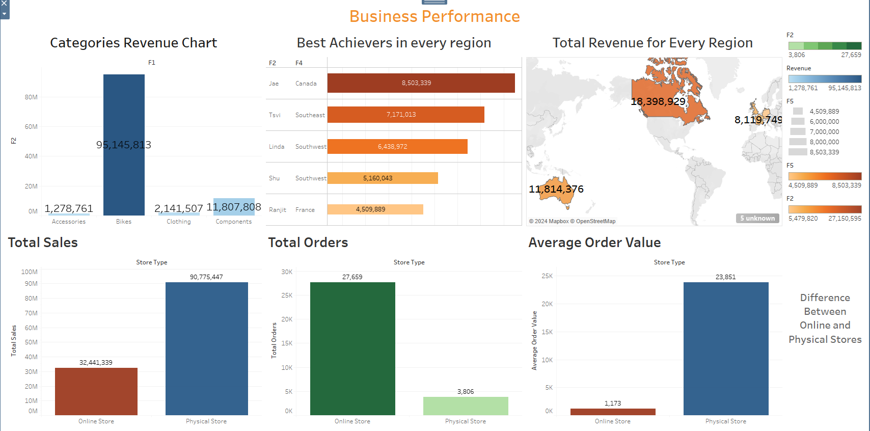
Live Application

Slide 7
Deliverables
Reports:
Final Report: Summary of data cleaning, analysis, and forecasting process.
Tableau Dashboard: Interactive dashboard for stakeholders to explore the data.
Other Final Products:
Python scripts used for preprocessing and forecasting.
SQL Queries for business questions.
Tableau workbook or Tableau Public link for dashboard access.

Slide 8
Project Team
Name
Ebraam Girgis Shenouda Boules
Mohamed Ahmed Mohamed Fetyan
Hazem Hassan Ahmed Hassan
Abdelshafi Saeed Abdelshafi Elsayyed
Sayed Ahmed Sayed Elbaradei

Slide 9
Project Team
Project Pipeline:
Data Preprocessing: SQL and Python for data cleaning.
Data Analysis: Exploratory analysis using SQL and Python (pandas, Matplotlib).
Forecasting: Regression modeling with Python (scikit-learn).
Visualization: Tableau dashboard creation.
Timeline:
Week 1: Data cleaning and preprocessing.
Week 2: Business questions and initial insights.
Week 3: Forecasting models and trends.
Week 4: Visualization and final presentation.

Slide 10
Any Questions

Slide 11
Thank You

